Slide 1
Azure Data Factory
How to Create Azure Data Factory

Slide 2
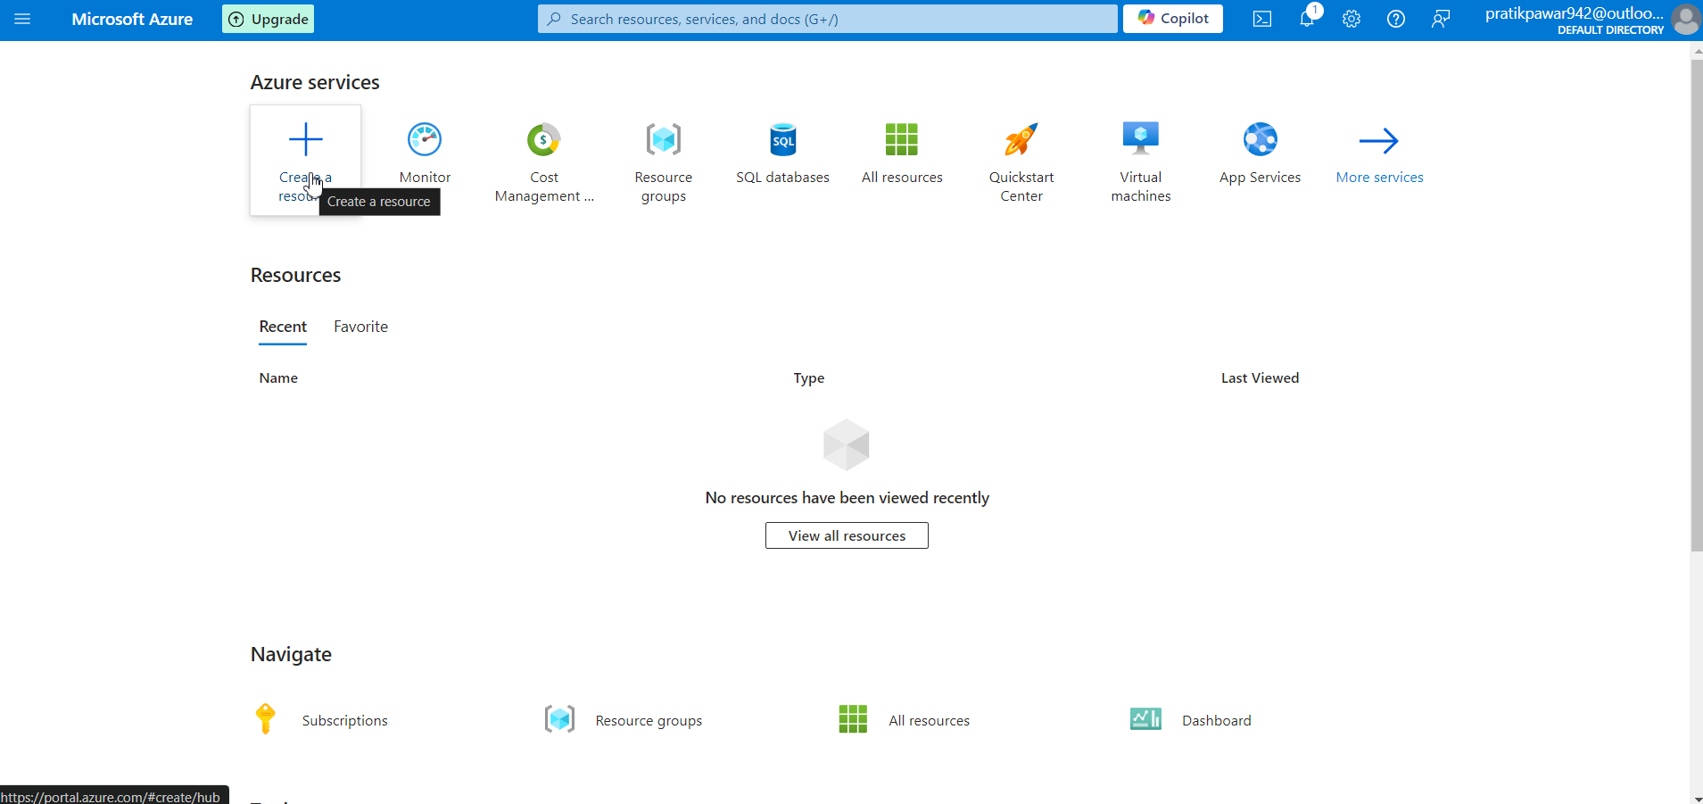
Create Resource

Slide 3
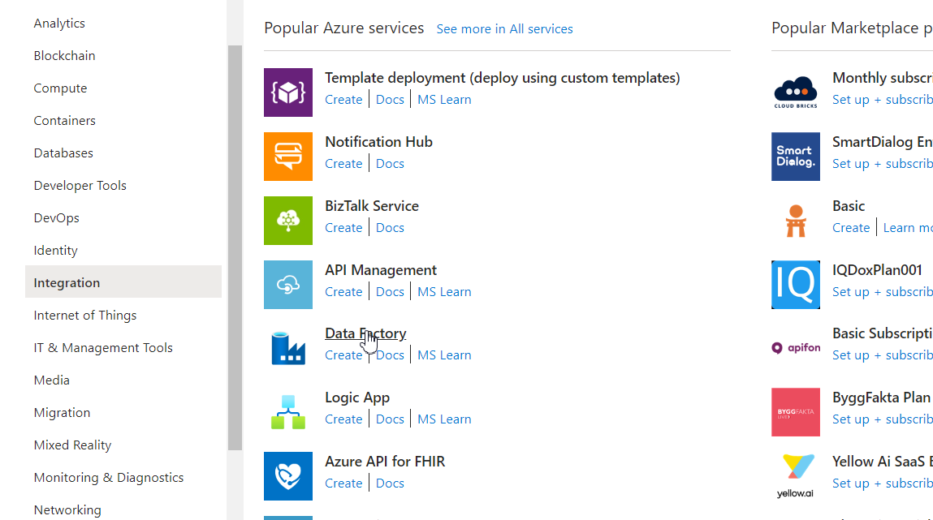
Select Data Factory

Slide 4
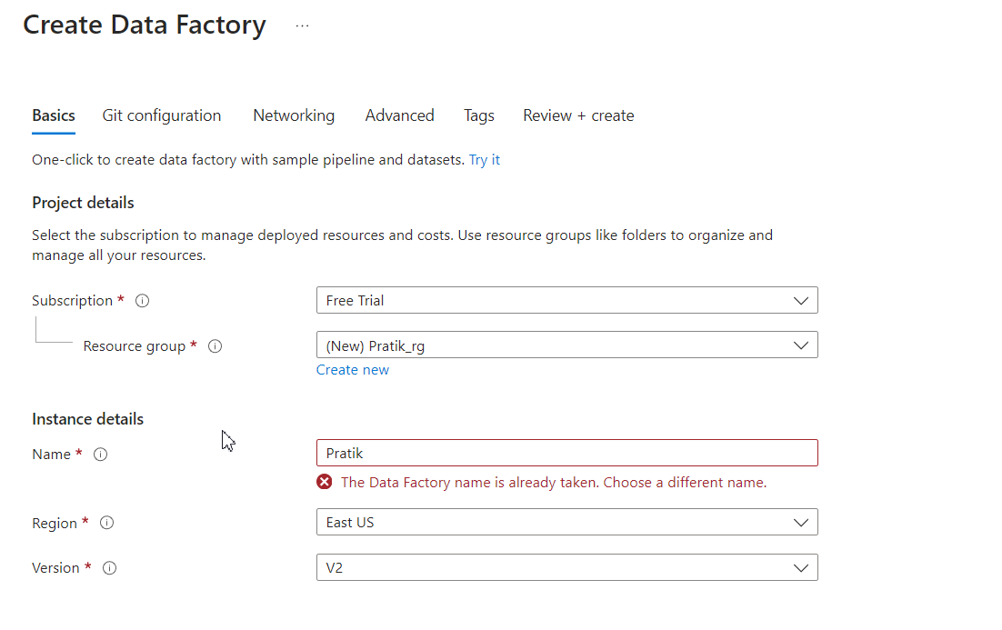
Resource Group and Instance Details

Slide 5
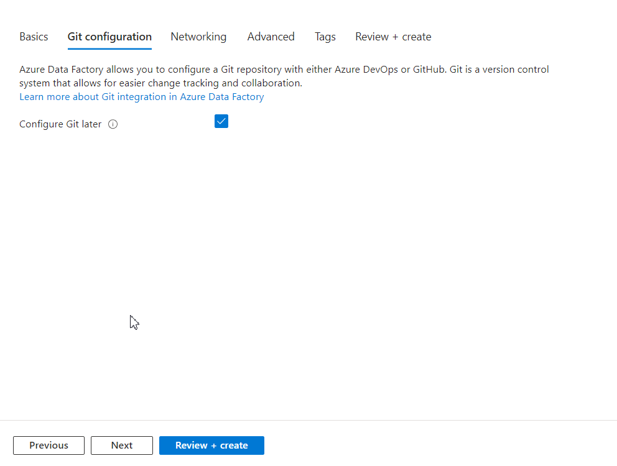
Git Configuration

Slide 6
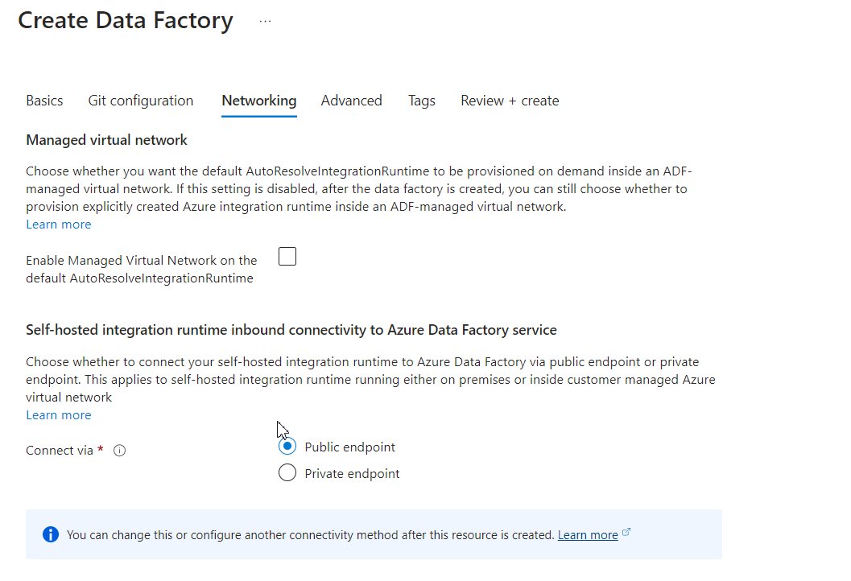
Networking

Slide 7
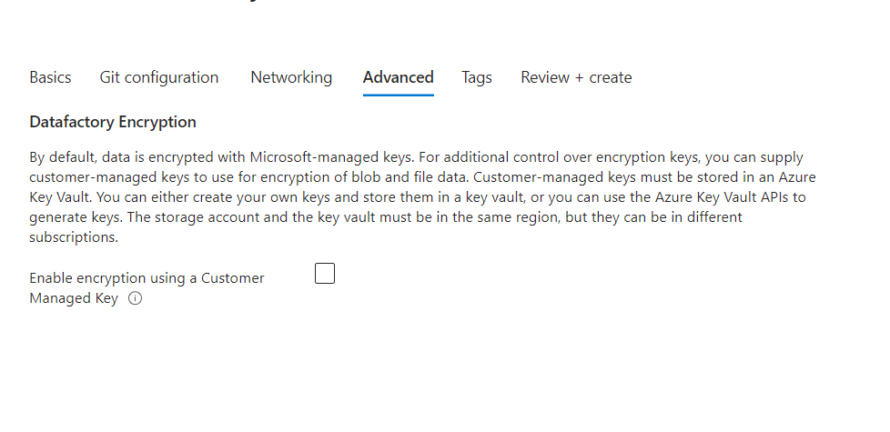
Datafactory Encryption

Slide 8
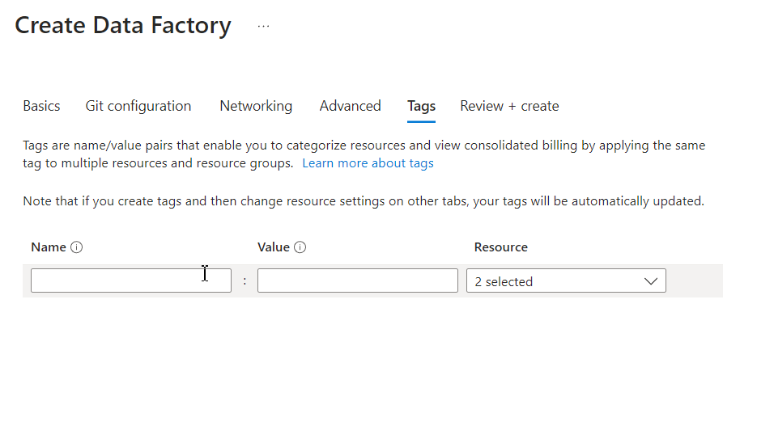
Tags

Slide 9
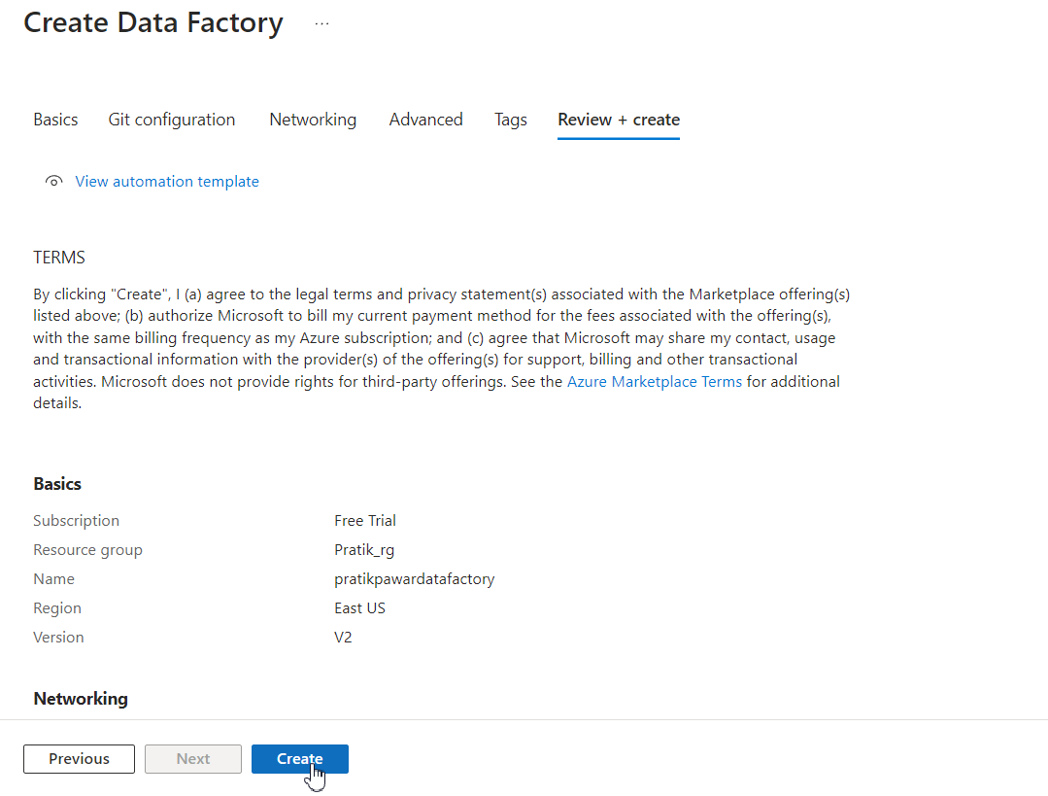
Review + Create

